Slide 1


Docker
Docker Volume

Slide 2
Lesson Agenda
To Understand the usage of a docker volume.

Slide 3
Introduction
There are two main categories of data — persistent and non-persistent.
Persistent is the data we need to store. Non-persistent is the data we don’t need to store.
To deal with non-persistent data, every Docker container gets its own non-persistent storage. This is automatically created for every container and is tightly coupled to the lifecycle of the container.
To deal with persistent data, a container needs to store it in a volume. Volumes are separate objects that have their lifecycles decoupled from containers. This means you can create and manage volumes independently, and they’re not tied to the lifecycle of any container. Net result, you can delete a container that’s using a volume, and the volume won’t be deleted.

Slide 4
Docker Volumes
Containers are designed to be immutable. This basically means that containers are read-only. It’s a best practice not to change the configuration of a container after it is deployed.
many applications require a read-write filesystem in order to simply run – they won’t even run on a read-only filesystem. Every Docker container is created by adding a thin read-write layer on top of the read-only image it’s based on.
The writable container layer exists in the filesystem of the Docker host, and you’ll hear it called various names. These include local storage, ephemeral storage, and graphdriver storage.

Slide 5
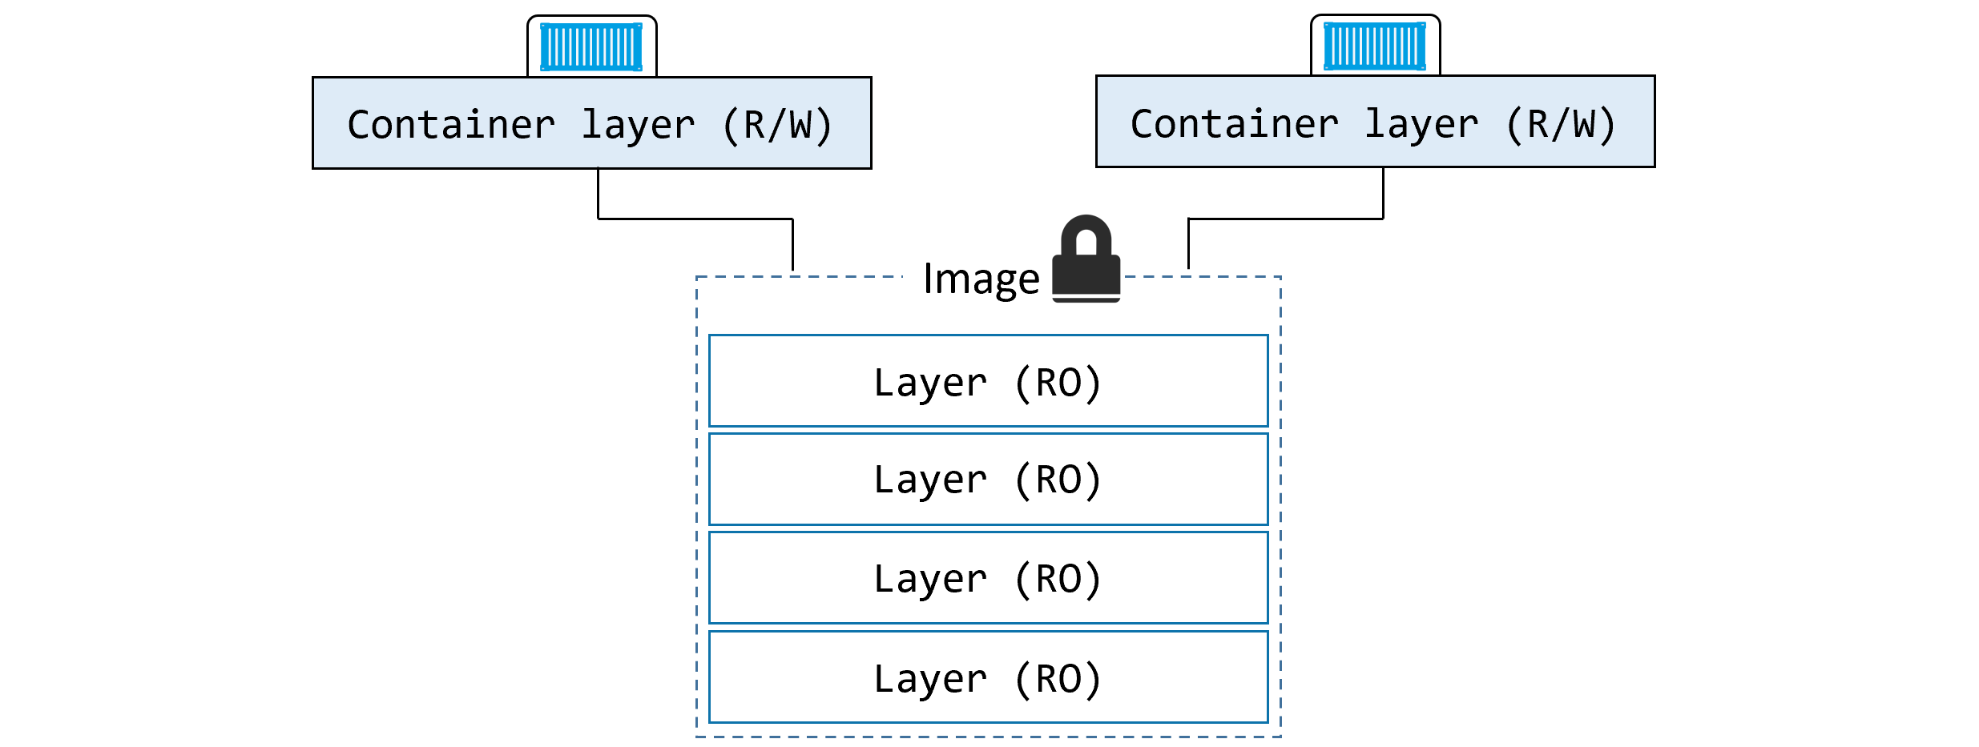

Slide 6
Docker volume cont.
This thin writable layer is an integral part of a container and enables all read/write operations. If you, or an application, update files or add new files, they’ll be written to this layer. However, it’s tightly coupled to the container’s lifecycle — it gets created when the container is created and it gets deleted when the container is deleted. The fact that it’s deleted along with a container means that it’s not an option for important data that you need to keep (persist).
This writable layer of local storage is managed on every Docker host by a storage driver.
If the application(or the container), does not deal with persistent data, we do not need to do anything else.

Slide 7
Persistent data
Volumes are the recommended way to persist data in containers. There are three major reasons for this:
Volumes are independent objects that are not tied to the lifecycle of a container
Volumes can be mapped to specialized external storage systems
Volumes enable multiple containers on different Docker hosts to access and share the same data
First you create a volume, then you create a container and mount the volume into it. The volume is mounted into a directory in the container’s filesystem, and anything written to that directory is stored in the volume. If you delete the container, the volume and its data will still exist.

Slide 8
Creating a volume
By default, Docker creates new volumes with the built-in local driver
volumes created with the local driver are only available to containers on the same node as the volume. You can use the -d flag to specify a different driver.
Third-party volume drivers are available as plugins. These provide Docker with seamless access external storage systems such as cloud storage services and on-premises storage systems including SAN or NAS.

Slide 9
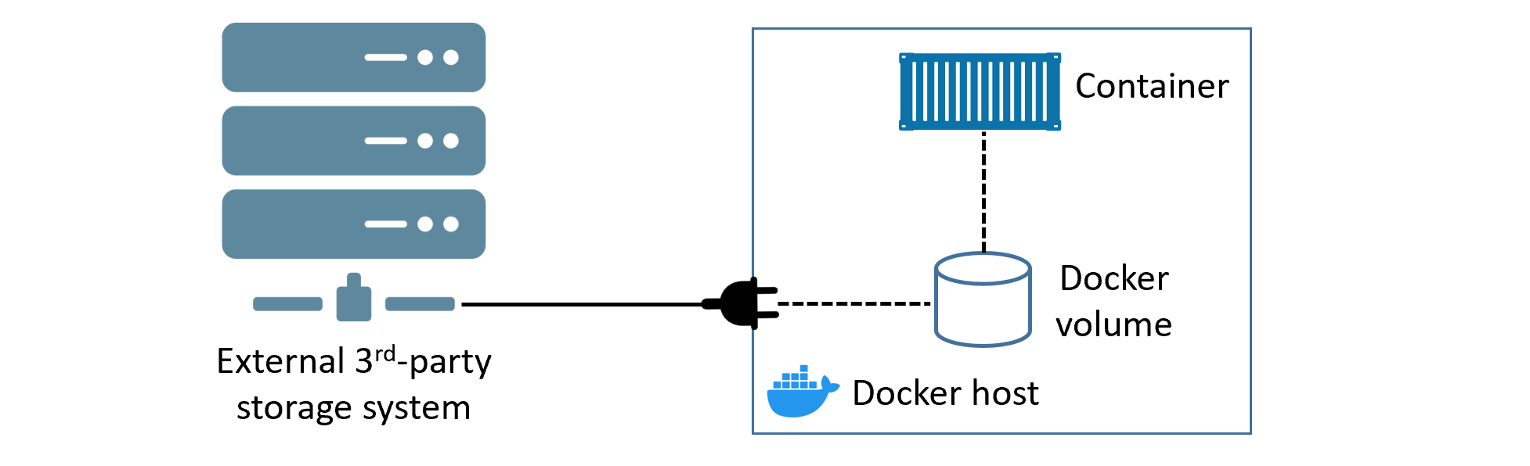

Slide 10
Volume Deletion
All volumes created with the local driver get their own directory under /var/lib/docker/volumes on Linux, and C:\ProgramData\Docker\volumes on Windows.
There are two ways to delete a Docker volume
docker volume prune
docker volume rm
docker volume prune will delete all volumes that are not mounted into a container or service replica.
docker volume rm lets you specify exactly which volumes you want to delete. Neither command will delete a volume that is in use by a container

Slide 11
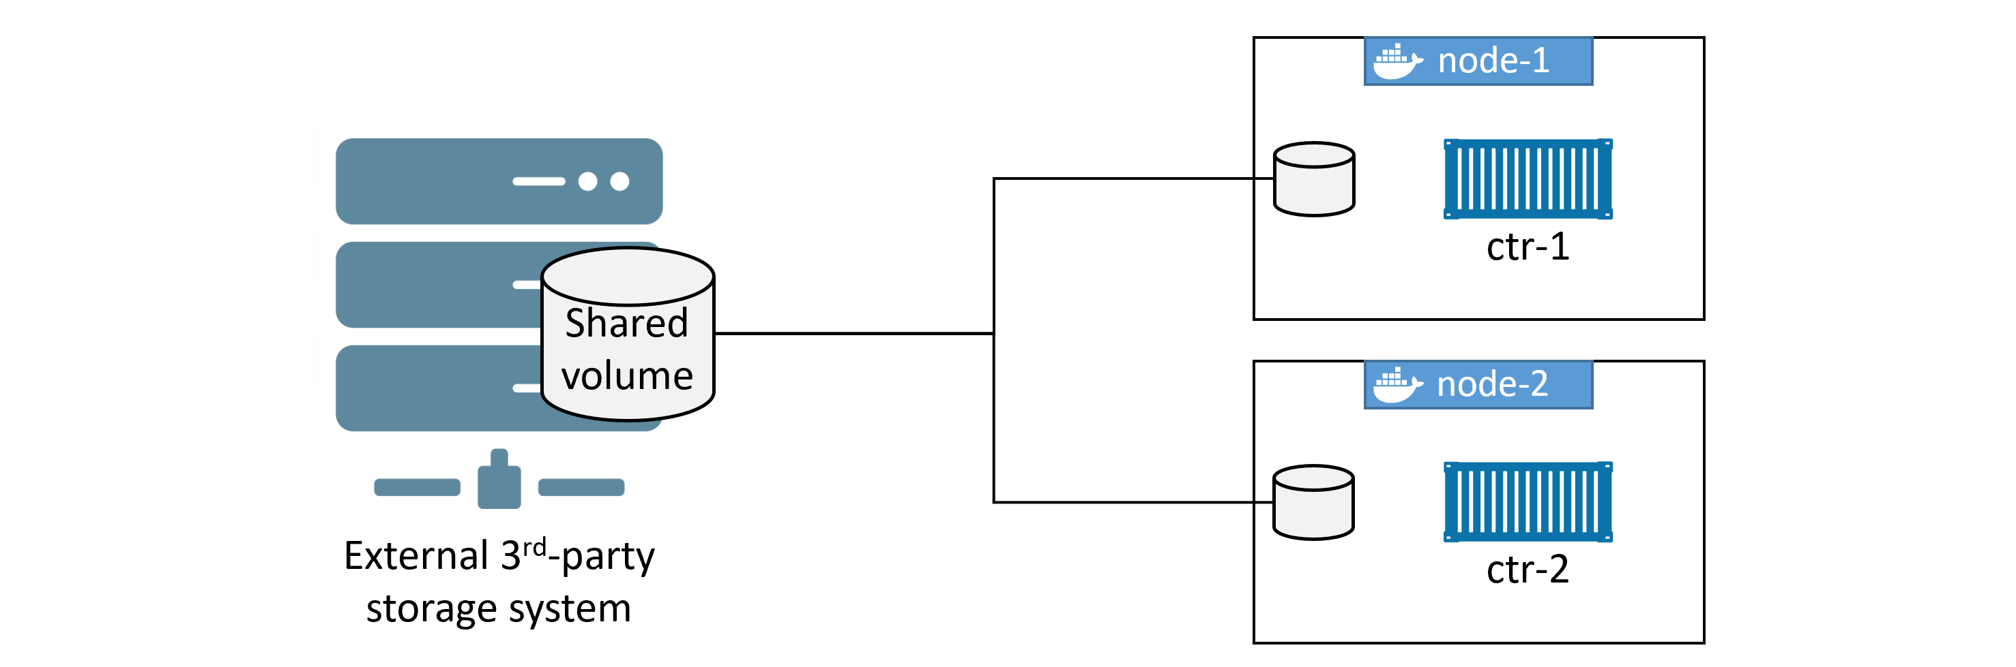

Slide 12
A word of Caution
A major concern with any configuration that shares a single volume among multiple containers is data corruption.
The application running in ctr-1 on node-1 updates some data in the shared volume. However, instead of writing the update directly to the volume, it holds it in its local buffer for faster recall (this is common in many operating systems). At this point, the application in ctr-1 thinks the data has been written to the volume. However, before ctr-1 on node-1 flushes its buffers and commits the data to the volume, the app in ctr-2 on node-2 updates the same data with a different value and commits it directly to the volume. At this point, both applications think they’ve updated the data in the volume, but in reality only the application in ctr-2 has. A few seconds later, ctr-1 on node-1 flushes the data to the volume, overwriting the changes made by the application in ctr-2. However, the application in ctr-2 is totally unaware of this! This is one of the ways data corruption happens.
To prevent this, you need to write your applications in a way to avoid things like this.

Slide 13
Volume Plugins
Third party volumes are known as volume plugins
Docker Hub is the best place to find volume plugins. Login to Docker Hub, select the view to show plugins instead of containers, and filter results to only show Volume plugins. Once you’ve located the appropriate plugin for your storage system, you create any configuration files it might need, and install it with docker plugin install.
Once the plugin is registered, you can create new volumes from the storage system using docker volume create with the -d flag.

Slide 14
Demonstration
Let us try to create a volume and use it in containers

